Slide 1

Capstone Project

Slide 2



Personal BACKGROUND
(Name, Past Experience, Qualification, Career Summary)
Name : Swarna Sai Sreekar
Past Experience : Experience in previous Trainings with MERN stack, Spring Boot and GEN-AI Training
Qualification : Bachelor of Technology in CSE
Career Summary : To work in a dynamic environment that uses my skills and expertise in process of growth and development while allowing me to learn and enrich my competencies
www.collaberadigital.com

Slide 3


Key Takeaways/Learnings from the Program (HTD)
During my two-month training at Ascendion, I gained in-depth knowledge and practical experience in several key areas :
End-to-End Quality Engineering (QE) Expertise Skilled in manual and automation testing across functional, performance, and security domains, with strong test design and execution practices.
Full-Stack Test Automation Hands-on experience building scalable Selenium WebDriver frameworks with Java, TestNG, POM, Log4j, and Maven for CI/CD pipelines.
API Automation & Integration Proficient in REST API testing using Postman and Newman CLI, validating responses and integrating with Jenkins for automation.
Performance Testing Created JMeter scripts simulating realistic load scenarios with CLI-based execution and reporting for API and web performance.
Agile Testing with Jira & Xray Managed testing workflows in Jira Scrum boards, including sprint planning, bug tracking, and test executions using Xray.
DevOps & CI/CD Testing Implemented Shift-Left and Shift-Right strategies integrated with Jenkins, GitHub Actions, and SonarQube for continuous quality feedback.
Exploratory, Non-Functional & Mobile Testing Experienced in mobile automation using Appium on real devices and simulators.

Slide 4

Problem Statement of the Capstone Project
Demonstrate end-to-end Quality Engineering skills with automated testing for web and APIs.
Develop scalable Selenium WebDriver UI tests using Page Object Model, logging, and assertions.
Create Postman API automation collections and run via Newman locally and in CI/CD.
Manage test execution, reporting, and tracking using Jira and Xray.
Optionally implement mobile automation (Appium) and performance testing (JMeter).
Integrate tests and code into GitHub with branching strategies.
Optionally configure Jenkins pipelines for automated test execution.
Ensure robust, flexible, and maintainable automation supporting agile and DevOps workflows.

Slide 5
Reference Links :
Links 🔗 Web Application
https://demoqa.com/
🔗 API Base URL
https://api.restful-api.dev/objects
🔗 GitHub Repository
https://github.com/sreekar0122/CAPSTONE_COGNIXIA_WEB_API_MAY2025
🔗 JIRA or Documentation (Optional)
https://ascendionlearning.atlassian.net/jira/software/c/projects/SR/summary

Slide 6
Selenium Web UI Test Automation – Overview
Tech Stack: Java • Selenium WebDriver • TestNG • Maven Design Pattern: Page Object Model (POM)
Features:
Automated tests for login, forms, search, alerts, iframes, and windows
TestNG assertions and execution via testng.xml
Log4j logging for traceability
Screenshot capture on test failure
Cross-browser support (Chrome & Edge)
Headless mode toggle via config.properties
Utilities:
ClickOnElementUsingJS() – JS-based click handling
CaptureScreenshot() – Save failure screenshots
Execution:
Run with: mvn test or mvn clean install

Slide 7
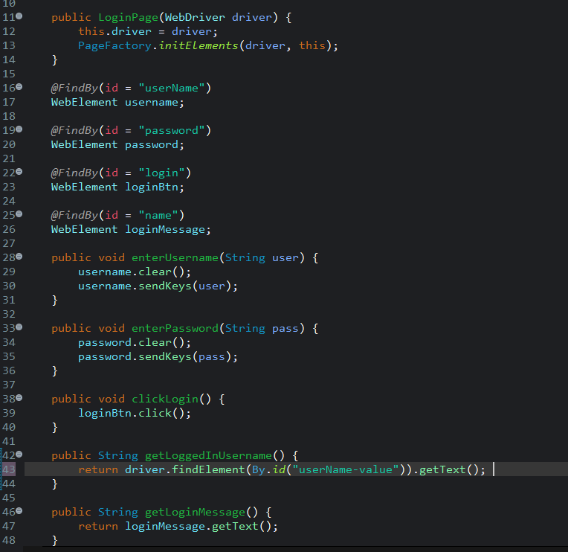
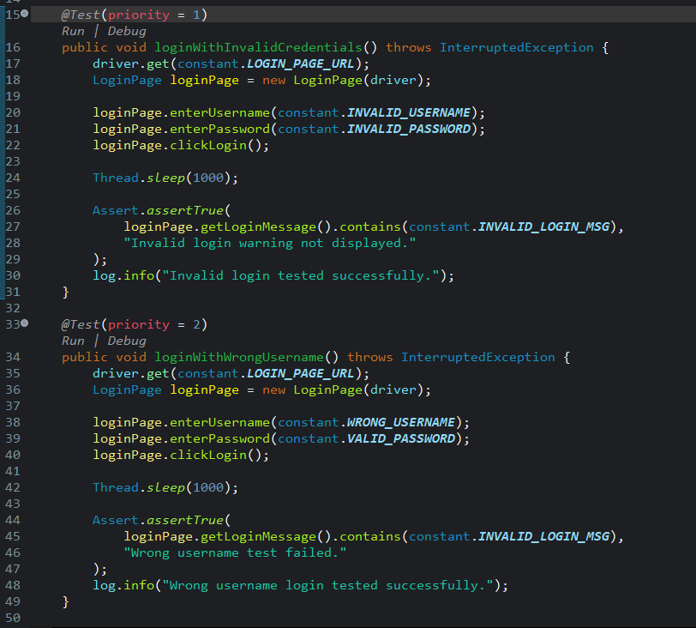
Login Functionality Page & Test of the Selenium project with screenshots

Slide 8
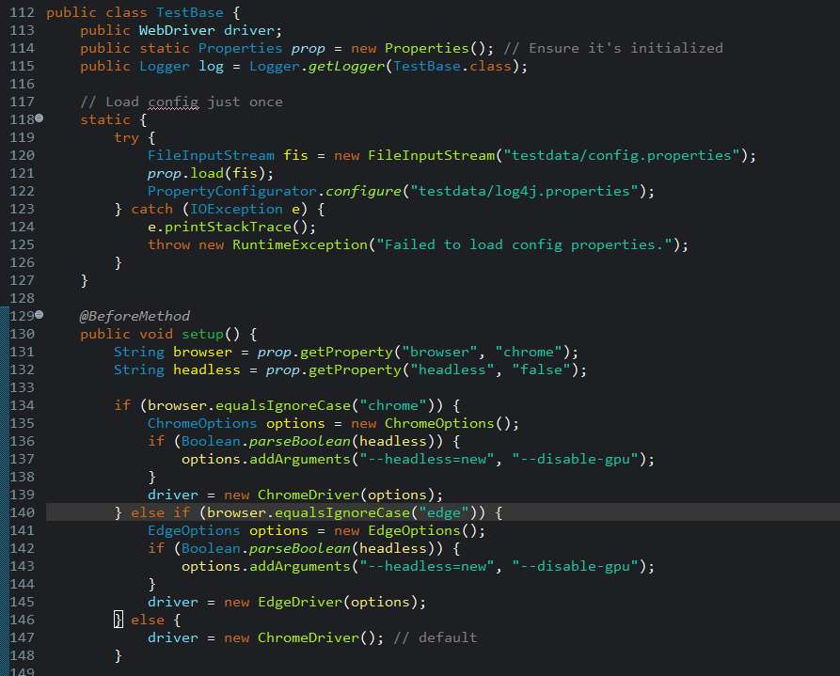
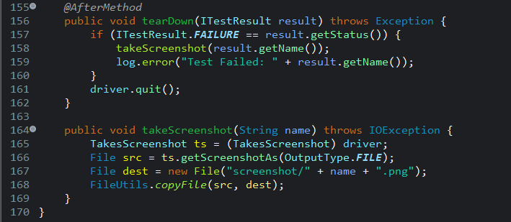

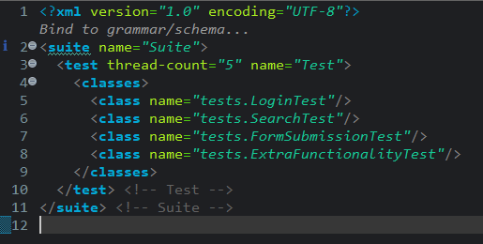
Test Base Before & After Method, Config.properties, TestNG.xml of the Selenium project

Slide 9
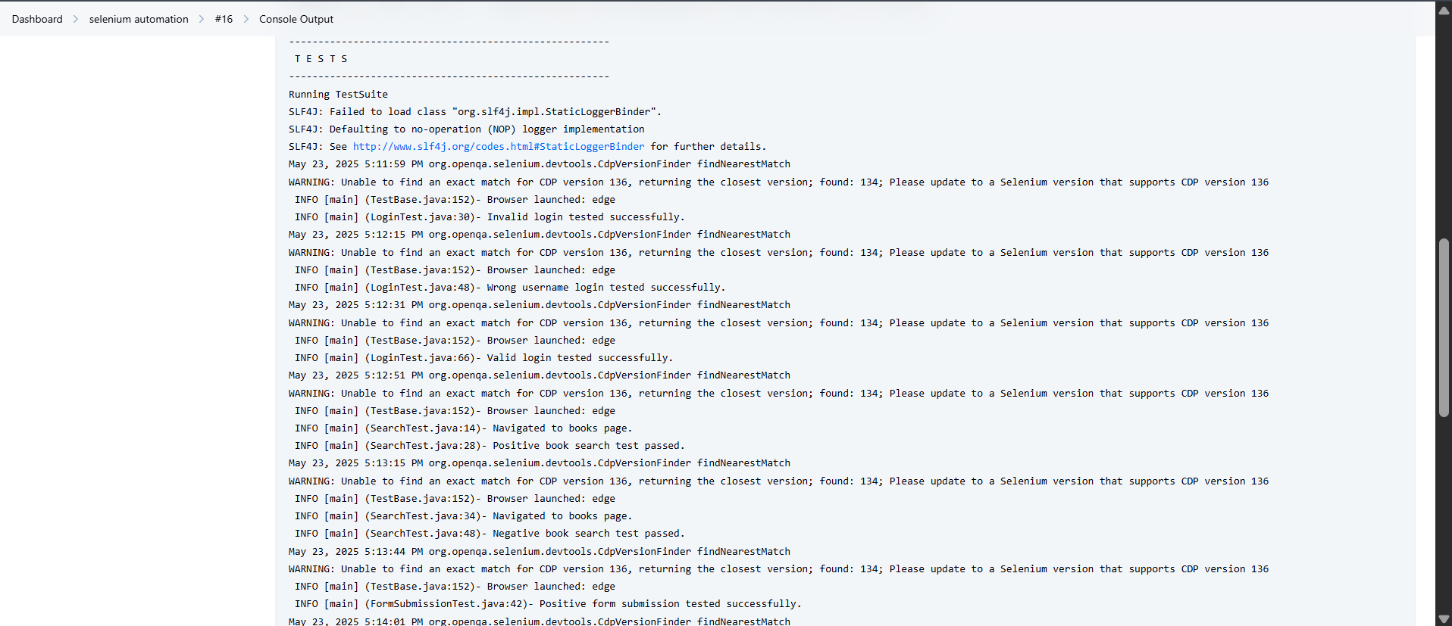
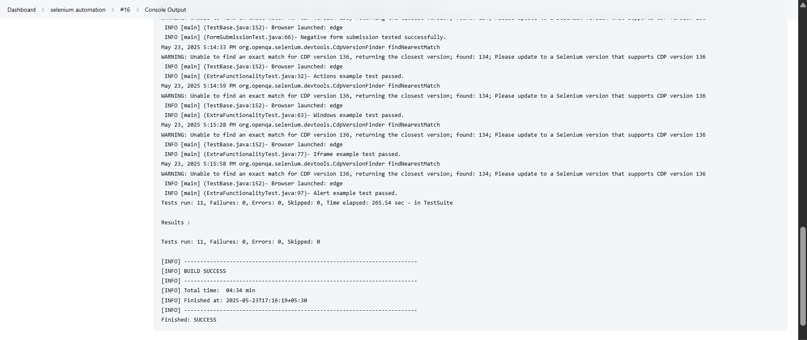
Test Results of the selenium project usin Jenkins
All 11 automated UI test cases passed successfully with no failures or errors.
Tests executed on Edge browser in headless mode, covering login, form, search, alert, iframe & window handling.

Slide 10


Selenium Form Submission Test Video

Slide 11

API Postman Test Video

Slide 12
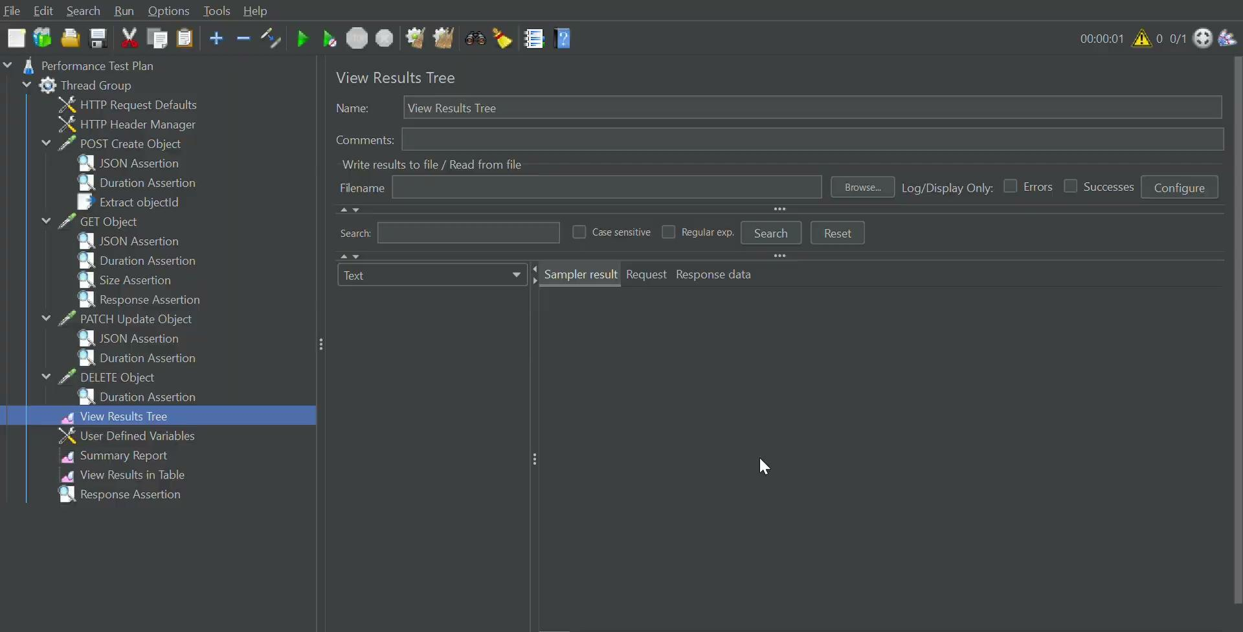
JMeter api.restful-dev Test Video

Slide 13
API Automation – Postman + Newman (CLI)
Tech Stack: Postman • Newman CLI • Jenkins (Batch script)
Requests Automated:
GET /objects — Fetch all objects
POST /objects — Add a new object
GET /objects/{{objectID}} — Fetch object by ID
PATCH /objects/{{objectID}} — Update object by ID
DELETE /objects/{{objectID}} — Delete object by ID
Validation Checks:
HTTP Status Codes: 200, 201
Response Body Content: e.g., Apple iPhone 14
Response Time: under 2000ms
Header Assertions: Content-Type: application/json
CI Integration – Jenkins:
Runs Newman via batch script
Generates HTML report using htmlextra reporter
Stores output at newman/report.html

Slide 14
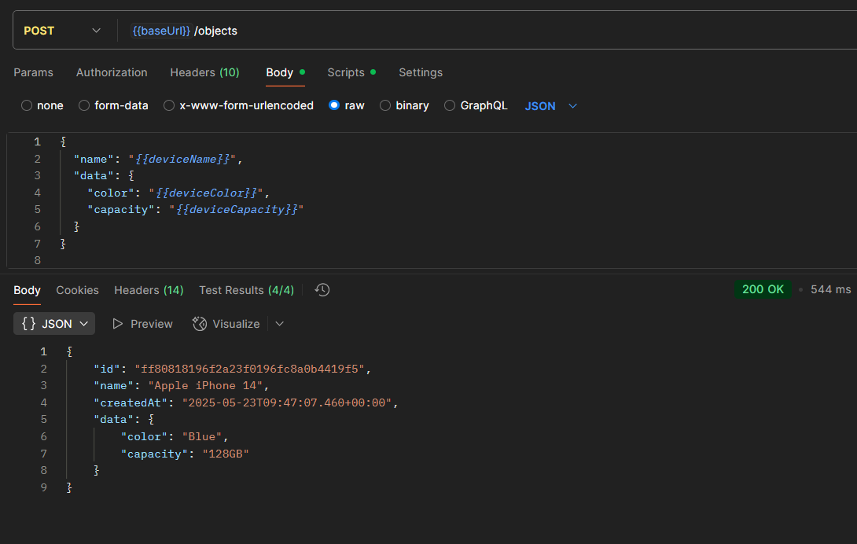
Postman Request Methods, Responses of the API(api.restful-dev) with screenshots

Slide 15
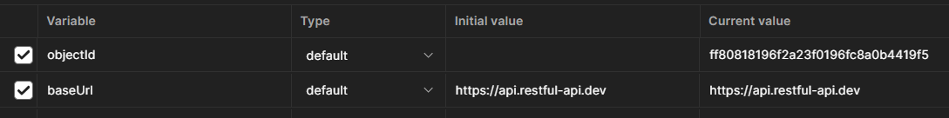
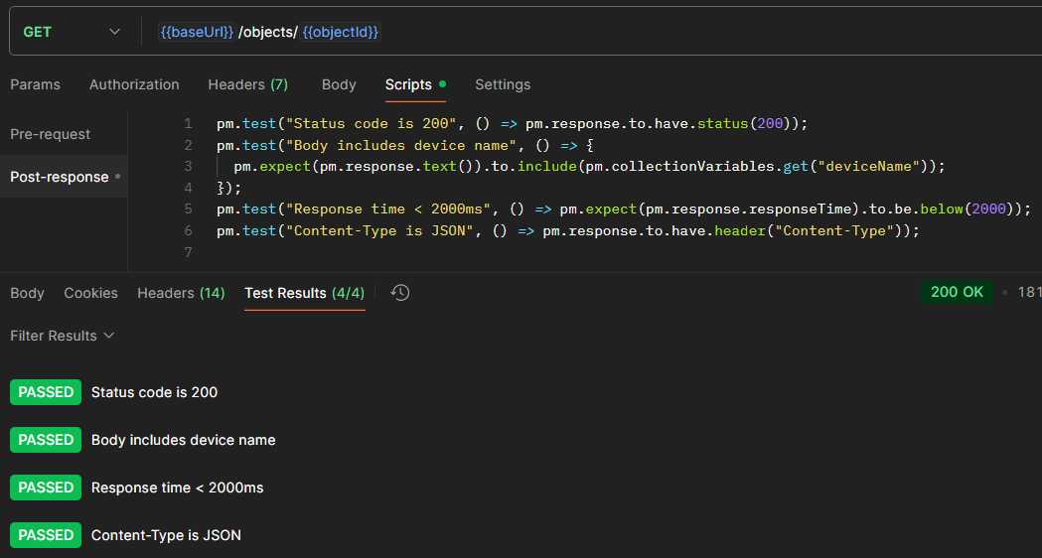
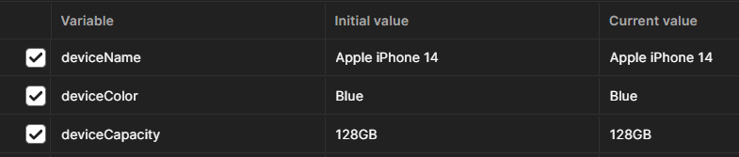
Postman Request Methods, Validations of the API(api.restful-dev) with screenshots
Environmental Variables
Validation Scripts
Collection Variables

Slide 16
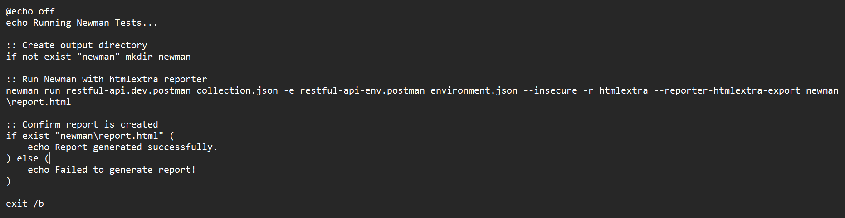
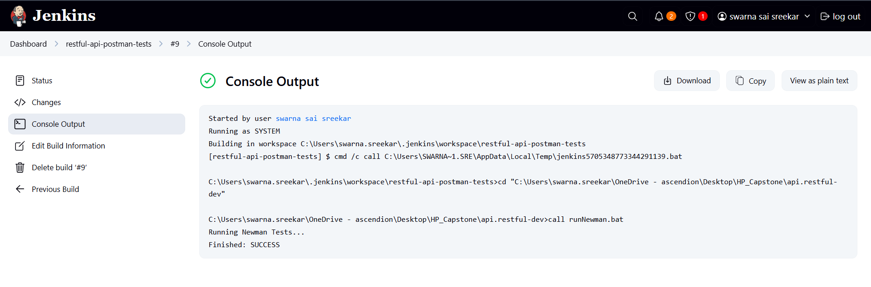
Generating Report using Newman by creating .bat file using Jenkins

Slide 17
Performance Testing – Apache JMeter
Tool: Apache JMeter (.jmx scripts) Purpose: Load & performance testing for APIs and web applications
Test Scenario Configuration:
Users: 10 virtual users
Ramp-up Time: 1 second
Delay Between Requests: 10 seconds
Test Duration: 120 seconds
CLI Execution & Report Generation:
jmeter.bat -n -t "path/to/test.jmx" -l "path/to/results.log" -e -o "path/to/HTMLReport"
Headless test execution
Generates detailed HTML reports for analysis

Slide 18
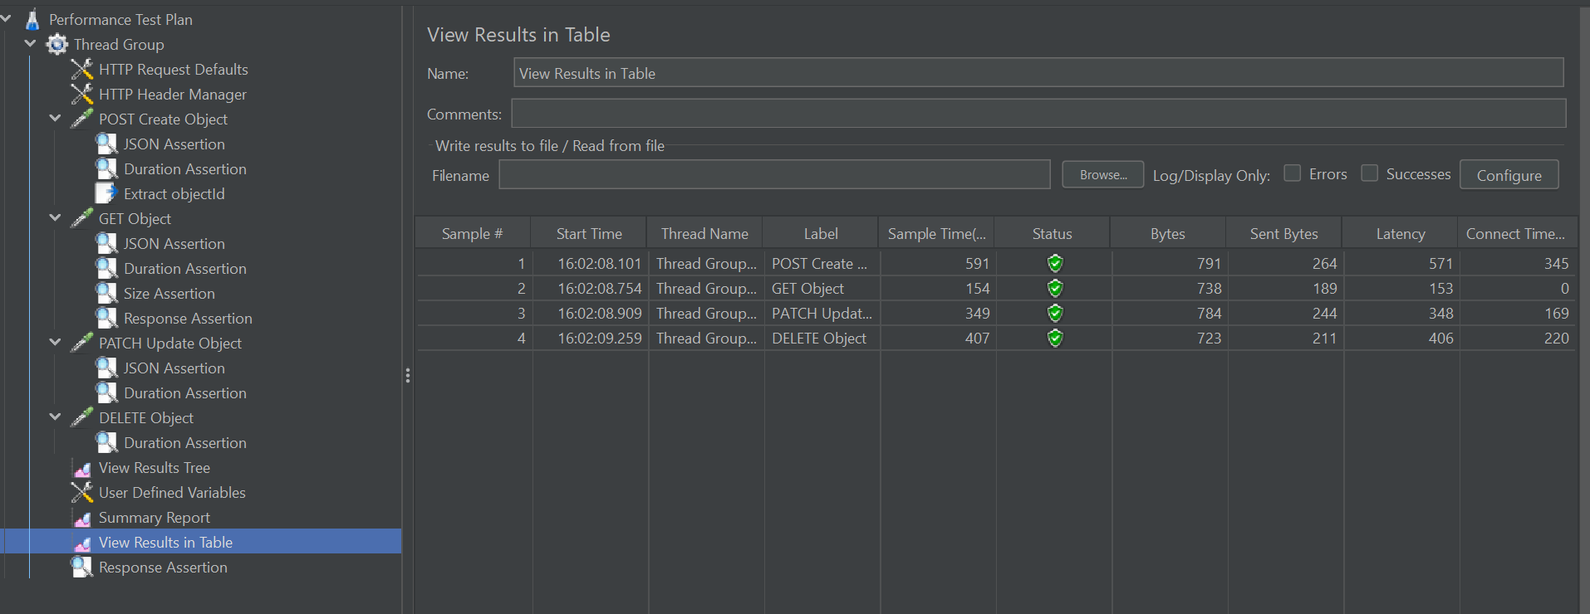
Responses of the API(api.restful-dev) of the JMeter with Result Table

Slide 19
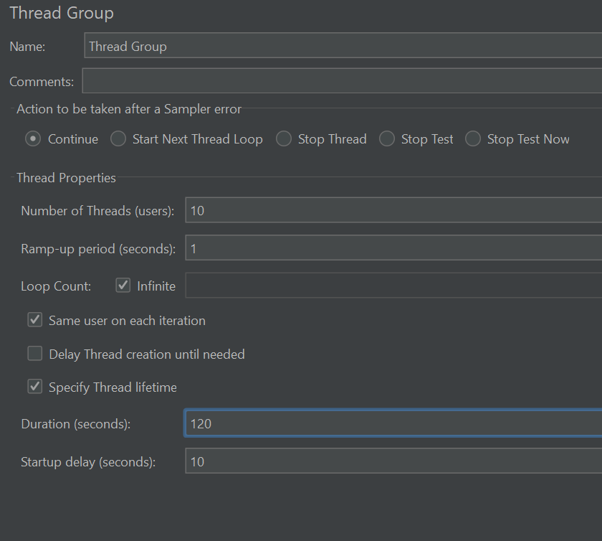
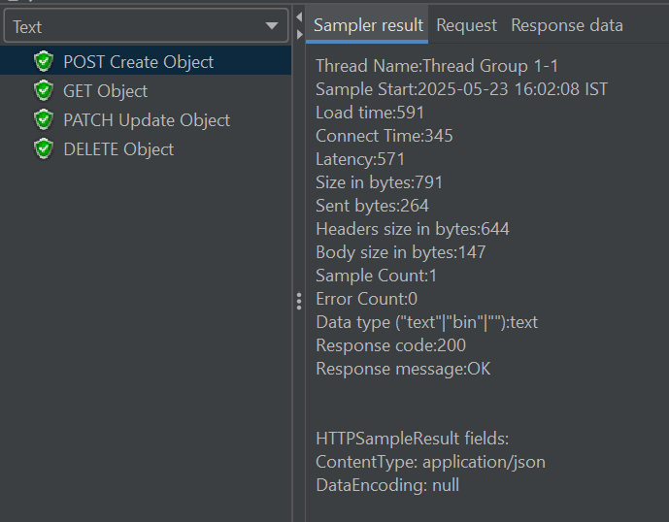
Responses of the API(api.restful-dev) of the Thread Group & Result Tree

Slide 20
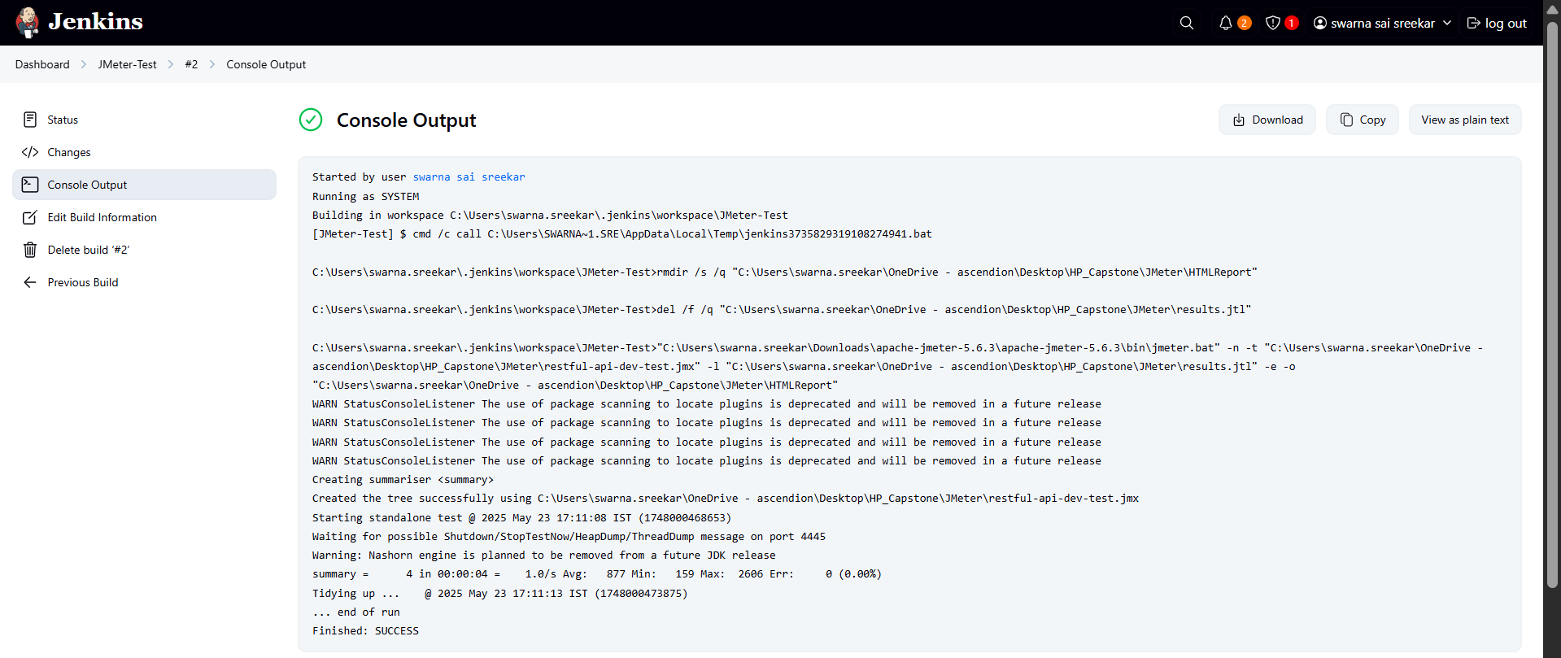
Results and HTML Report Generation of .jmx file using Jenkins

Slide 21
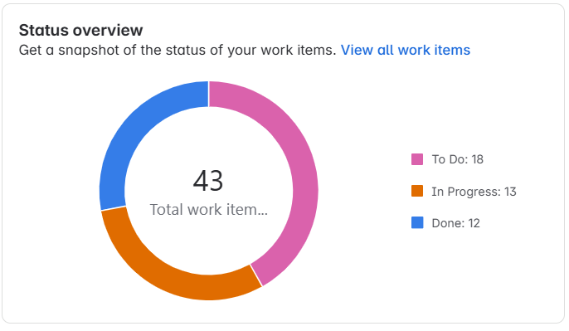
HP-Capstone(SR) Summary in SR - JIRA - Board
JIRA is leveraged for agile sprint tracking, task management, and test execution visibility using the Xray plugin.
Key Artifacts Tracked:
Sprint Summary & Active Sprint View
Epics, Stories, Tasks, and Backlog Items
Test Cases, Executions, and Pre-conditions (via Xray)
Bug Reports with status and traceability
Dashboards & Custom Filters with execution screenshots

Slide 22
Conclusion
Gained comprehensive Quality Engineering skills across manual, automation, API, mobile, and performance testing.
Developed and maintained scalable test automation frameworks using industry tools and best practices.
Integrated testing solutions within agile workflows and CI/CD pipelines for continuous quality assurance.
Managed end-to-end test execution, reporting, and defect tracking effectively using Jira and Xray.
Applied DevOps testing strategies like Shift-Left and Shift-Right for early and continuous feedback.
Built readiness to deliver robust, maintainable, and scalable testing solutions in real-world projects.
Strengthened practical experience with mobile automation and performance testing tools.

Slide 23
Thank You

